Slide 1

Why do Workers Quit?
Group 3
Notes:
Why do workers quit? When employees leave, there can be direct consequences to a company’s bottom line. The objective of our project is to answer this question by assessing a dataset for significant factors that contribute to a worker’s resignation, utilizing classification analysis techniques.

Slide 2

Agenda
Project Motivation
Data Preprocessing
Model Building
Conclusions
Applications and Concerns

Slide 3

1.
Project Motivation

Slide 4
What is Attrition?
A reduction in workforce
Slightly different from turnover
Two different types:
Positive: low-performers
Negative: high-performers
Notes:
Although most companies would naturally prefer their low-performers to resign, regardless of positive or negative, attrition can incur very significant costs that provide ample incentives for companies to reduce high rates.

Slide 5
1 - 1.2 x salary
Costs of Attrition
Up to $27 billion
¼ as profitable
Cost per leaver
Wasted in the US economy
As businesses with lower attrition
Notes:
A study conducted by Tom Marsden for the Strategic HR Review (2016)
Mahesh and Holtom’s long-term study of employee attrition and service-oriented companies (2012
Many companies find that of all resignations, the majority occur within 1-2 years of employment. With all the costs that such a resignation incurs, a company has every interest in assessing what factors cause attrition. This is what leads us to our project.

Slide 6
2.
Data Preprocessing
Notes:
~2:55

Slide 7
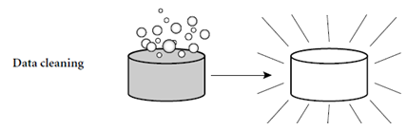
Data Cleaning
Raw data → cleaned data
Why?
How?

Slide 8
“Three-layer filter”
Common sense
“4 😞”
Round 1
Data summary
“3 😞”
Round 2
Regression
“15 😊”
Round 3

Slide 9
Common sense
Round 1
EmpNumber | ID number
StdHours | 80 for every records
Over18 | All adults
EmpCount | 1 for every records

Slide 10
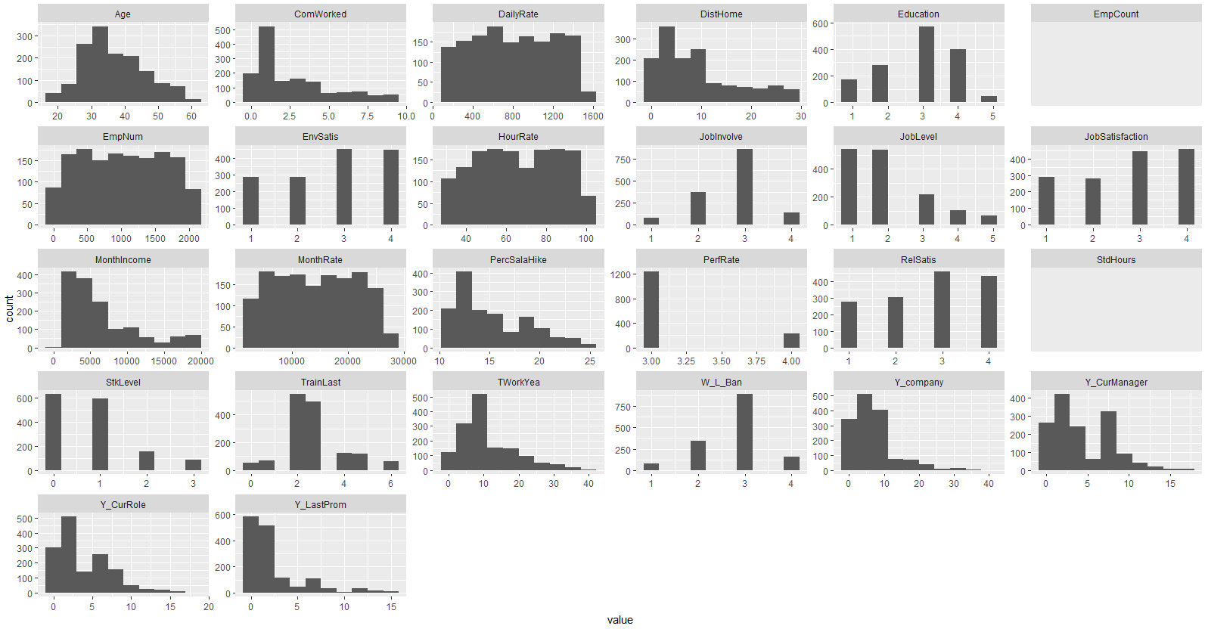
Data summary
Round 2

Slide 11
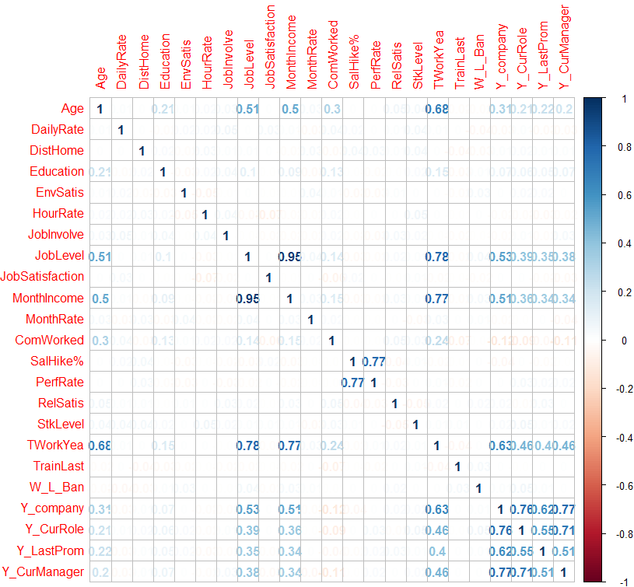
Data summary
Round 2
Potential objects:
MonthIncome
JobLevel
TWorkYear
Y_company
Y_CurRole
Y_LastProm
Y_CurManager

Slide 12
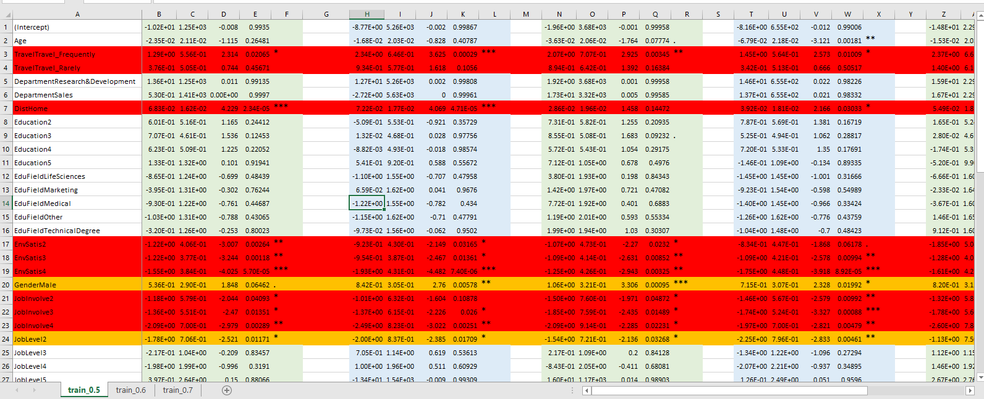
Regression
Round 3
Sample 1
Sample 2
Sample 3
Sample 4
...
The results for significant level are quite stable with different scenarios and sampling datasets.

Slide 13

Finals: 15 “Winners”
OverTime | JobInvolve | W_L_Ban
Travel | JobLevel | Y_LastProm
DistHome | JobSatisfaction | Y_company
EnvSatis | RelStatis | Y_CurManager
ComWorked | StkLevel | Gender

Slide 14
3.
Model Building
Notes:
~6:10

Slide 15
Which Is The Best One?
Logistic Regression
→ Go-to method for classification problems
Decision Tree
→ Tree-like model to represent decision making

Slide 16
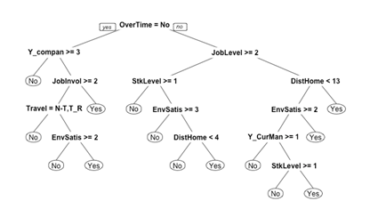
Results - Decision Tree
Decision Tree with OverTime as the first splitting node
EnvSatis, DistHome and StkLevel are the leaf nodes

Slide 17
Confusion Matrix For Decision Tree
Actual
Actual
Predicted | No | Yes
No | 718 | 91
Yes | 14 | 59
Predicted | No | Yes
No | 478 | 62
Yes | 23 | 25
Training Data
Accuracy = 0.881
Validation Data
Accuracy = 0.8554

Slide 18

Results - Logistic Regression
Attrition is most explained by?
Factor | Coefficient
Overtime | 1.78554
Travel_Frequently,rarely | 1.96141 / 1.0035
JobInvolve2,3,4 | -1.45/ -1.71/ -2.04
JobLevel2,3,4,5 | -1.31/-0.82/-2.31/-1.9

Slide 19
Confusion Matrix For Logistic Regression
Actual
Actual
Predicted | No | Yes
No | 721 | 113
Yes | 11 | 37
Predicted | No | Yes
No | 494 | 65
Yes | 7 | 22
Training Data
Accuracy = 0.8594
Validata Data
Accuracy = 0.8776

Slide 20
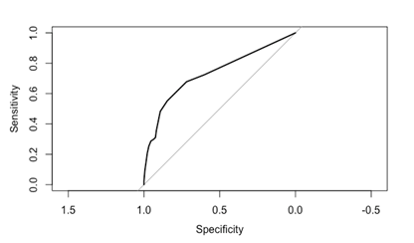
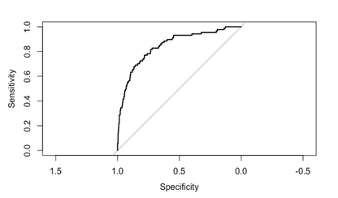
Area Under The Curve
Decision Tree → AUC = 0.7334
Logistic Regression → AUC = 0.8453

Slide 21
4.
Conclusions

Slide 22
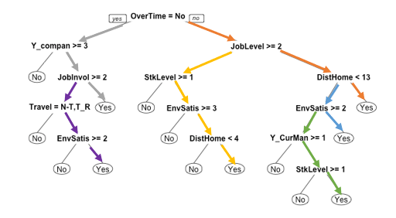
Rules From Decision Tree:-
IF OverTime=No And Y_Company<3 And JobInvol<2 THEN Attrition=Yes
IF OverTime=Yes AND JobLevel<2 AND DistHome>=13 THEN Attrition=Yes
IF OverTime=Yes AND JobLevel<2 AND DistHome<13 AND EnvSatis<2 THEN Attrition=Yes
IF OverTime=No And Y_Company<3 And JobInvol>=2 AND Travel!=N-T,T_R AND EnvSatis<2 THEN Attrition=Yes
IF OverTime=Yes AND JobLevel>=2 AND StkLevel<1 AND EnvSatis<3 AND DistHome>=4 THEN Attrition=Yes
IF OverTime=Yes AND JobLevel<2 AND DistHome<13 AND EnvSatis>=2 AND Y_CurMan<1 AND StkLevel<1 THEN Attrition=Yes

Slide 23

Attrition are due to :-
Employee with low Job Level working overtime whose Home Distance is greater than 13 miles.
Employee with low Job Level working overtime with Low Environment Satisfaction (Culture, Management styles and policies)
Employee with low Job Level working overtime with low Stock Option.
Employee with high Job Level with low Stock Option and Environment Satisfaction working overtime whose Home distance is greater than 4 miles.
Employee with less than 3 years in a company and low Environment Satisfaction with Frequent Travels.
Employee with less than 3 years in a company and low Job Satisfaction.

Slide 24
Interpretation From Logistics model:-
We got significant variables as below:
Travel, DistHome, EnvSatis, JobInvolve, JobLevel, JobSatisfaction, ComWorked,OverTime, RelSatis, StkLevel, W_L_Ban, Y_LastProm,Y_Company,Y_CurManager
Employees who travel frequently are 1.96 times to leave the organization than those who don't travel
Employees with High Environment Satisfaction are -1.44 times to leave the organization than those with low Environment Satisfaction
Employees with High Job Involvement are -2.03 times to leave the organization than those with low Job Involvement
Employees with high Job Level are -2.31 times to leave the organization than those with low Job level.
Employees with high Job Satisfaction are -1.01 times to leave the organization than those with low Job Satisfaction.
Employees who work Overtime are 1.78 times to leave the organization than those who don't work overtime.
Employees with Medium Stock option are -1.24 times to leave the organization than those with low Stock option.

Slide 25
Conclusion from the Models:-
Overtime (Working Overtime affects the quality of life of an employee)
Job Role (Employees who do not like their current Job Positions).
Job Level (Employees who believe they deserve a higher job level are prone to leaving the organization).
Total Working Years (A portion might be retiring or looking for more challenges)
Monthly income (Income might be a determinant factor for employees to leave the organization)
Other Factors include Frequent Travel, Distance from Home, No.of companies the employee has worked before and work life balance

Slide 26

5.
Applications & Concerns
Gartner : “Today’s average employee is in the same role 50% longer than before 2008”

Slide 27
Concerns:
According to the Gartner report on workforce activity in 2Q18 says that lack of future career development remains a main key driver for the employee attrition
cited by 40% of departing employees as a dissatisfying factor in their job
At the same time, 28% of employees are actively seeking a job and 42% are passively open to new opportunities

Slide 28
Assumptions we have made:
Monthly income is deduced from hourly/weekly income
There are no miscommunication between supervisors/managers and other team members
Employee is adhering to the company's ethical and time compliance policies
The concerned organization is a registered corporate entity following all the legal guidelines and rules

Slide 29
What you must have thought:
Gender
Location of the work
Personal Reasons(Maternity/family/sickness)
Facilities provided by the organization

Slide 30
What our analysis gave us:
Overtime, stretching work hours
More than 2 years old employees in the organization
Frequent travels, and
Job Level, dissatisfaction with roles and responsibilities

Slide 31
Reason/Solutions for retention:
Poor Compensation “Last quarter, nearly 37% of the global labor force reported leaving their previous employers due to their compensation”. The regular monitoring of employees’ compensation can help solve this issue
Bad relationship between co-workers: Project building exercises helps in the healthy work atmosphere
Dissatisfaction for roles and responsibilities: conduct effective exit interviews/ proper communication at the first sign of attrition and proposing hike in the salary
Better proposals from rival organization/ comparison from peers’ employer: This needs a long-term planning for setting up the niche corporate environment
Bad Leadership(Unworthy promotions): Hard- working and sincere employees should get more responsibilities for smooth management work

Slide 32
Thank you!
Any questions?

